Slide 1

CSE-302
DatabaseManagementSystem
Sessional

Slide 2

Old Home Database Management System

Slide 3
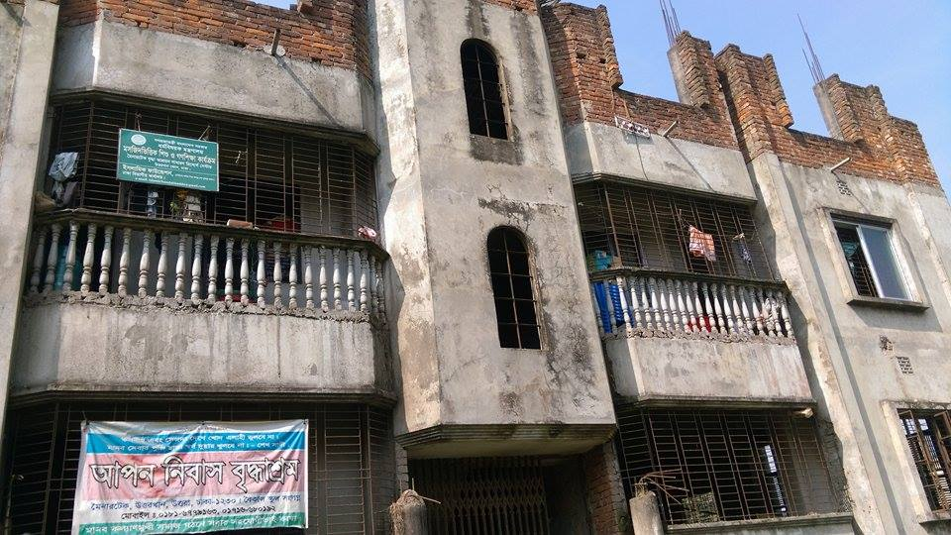
APON NIBASH OLD HOME

Slide 4
GROUP-2 MEMBERS
201514013 Jannatul Maowa Shaila
201514029 Fatema Binte Alam
201514032 Mohoshina Akter Toma
201514039 Nuzhat Tabassum Promi
201514046 Syeda Nusraht Khaledur

Slide 5
Agenda
Project Overview
System Functionality
Questions

Slide 6
Project Overview
The main objective of this project is to design and develop an old home database management system.
This system will be implemented in oracle database, php and html.
The project is very useful for those who want to know about old home, interested to donate and to computerize the management system.

Slide 7
System Functionality
The functionality for the project is divided among the viewers and administrators of the old home database management system.
Administrator Functionality
Viewer Functionality

Slide 8
Administrator Functionality
Login/Logout
Employee management
1. Monthly salary
2. Add/Delete/Modify information
Older people management
1. Registration
2. Add/Delete/Modify information
3. Buried people list
Modify details of web-page

Slide 9
Viewer Functionality
Overview details
Donation details
Donner list
Total cost

Slide 10
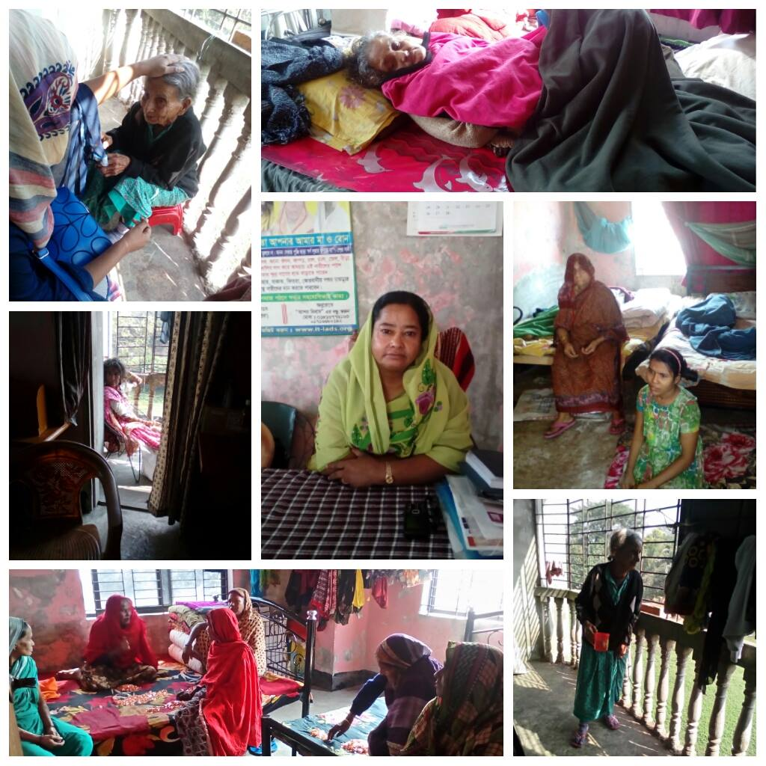

Slide 11
THANK YOU

